Slide 1
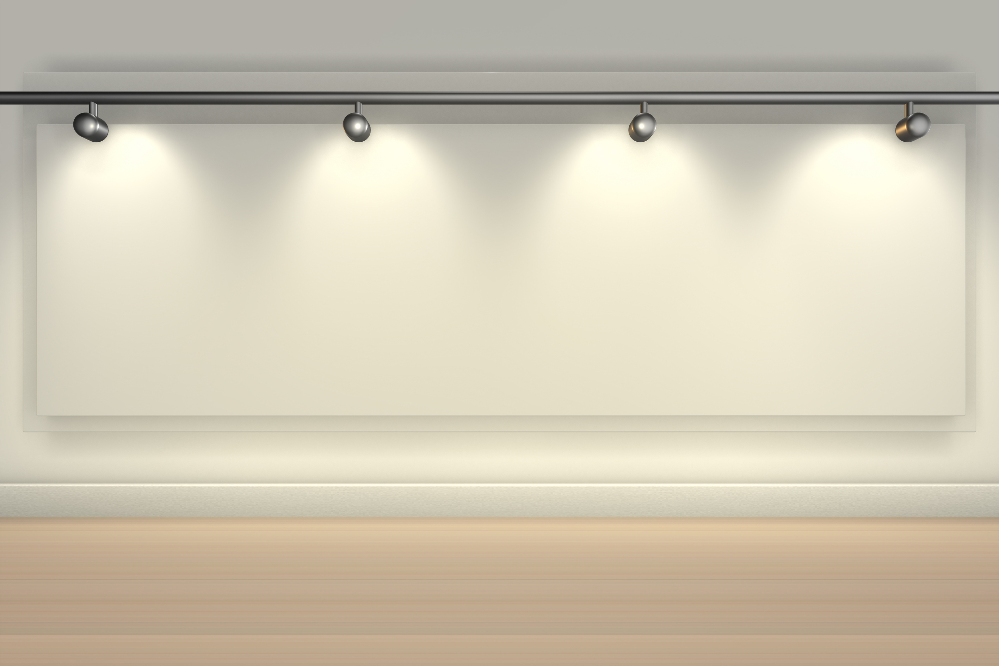



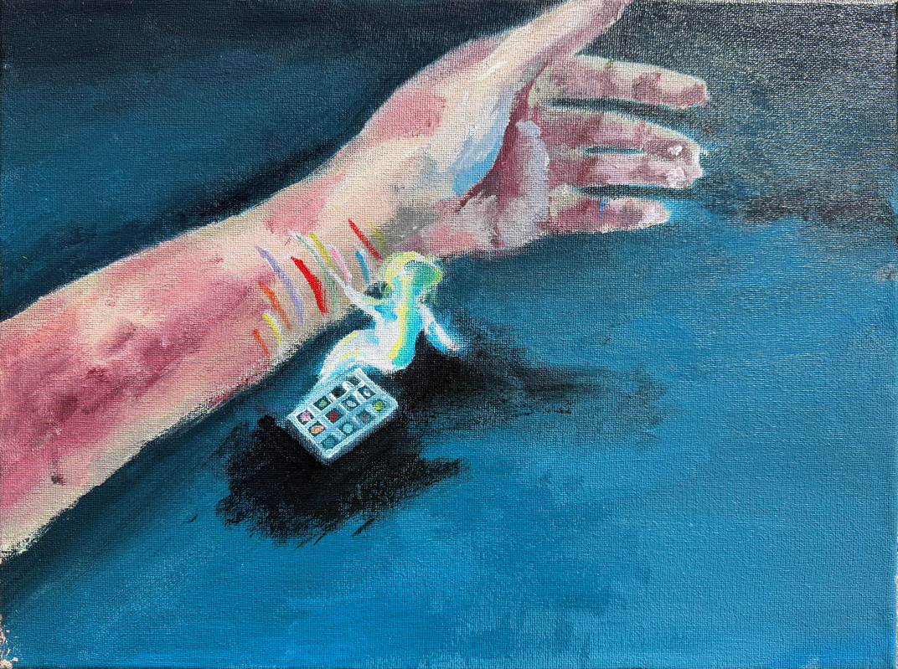
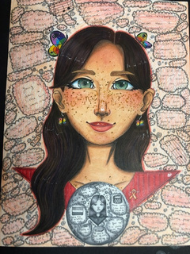
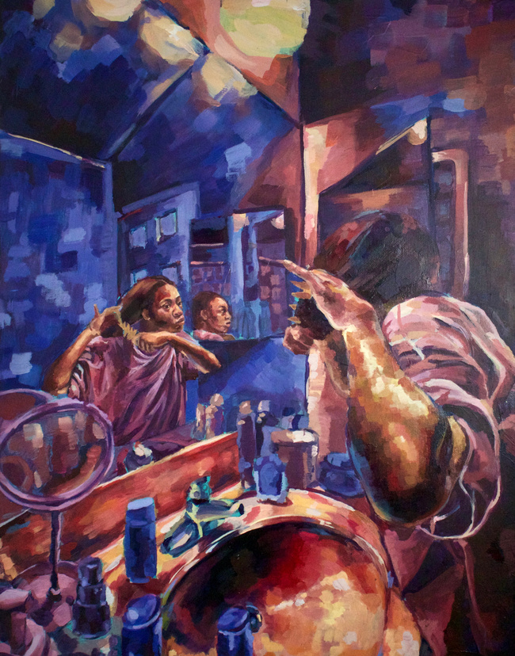
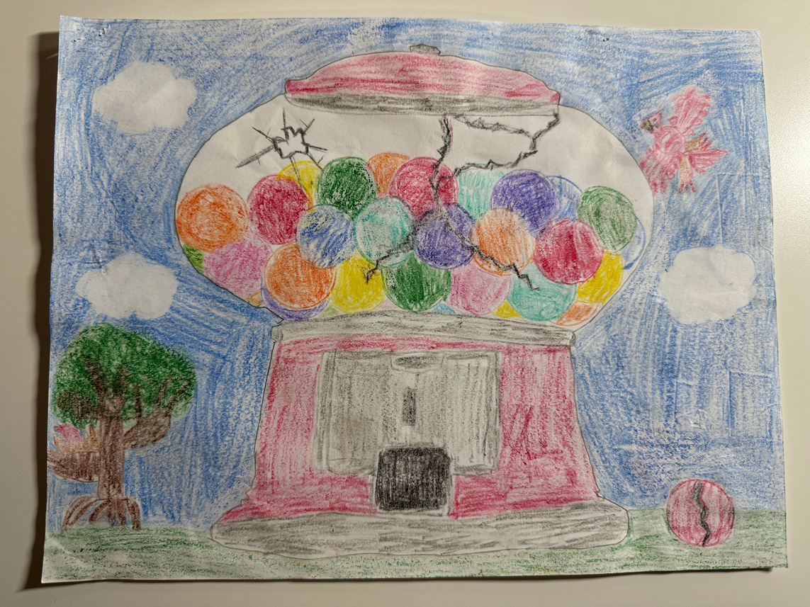

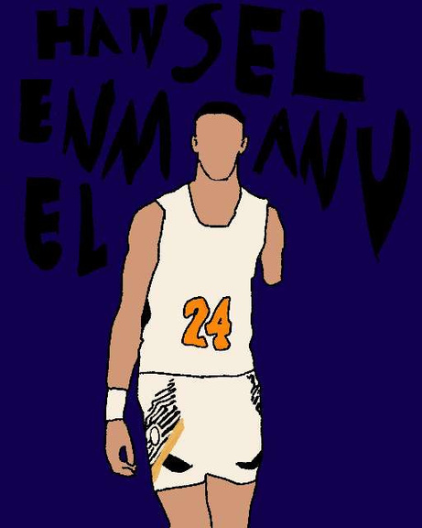
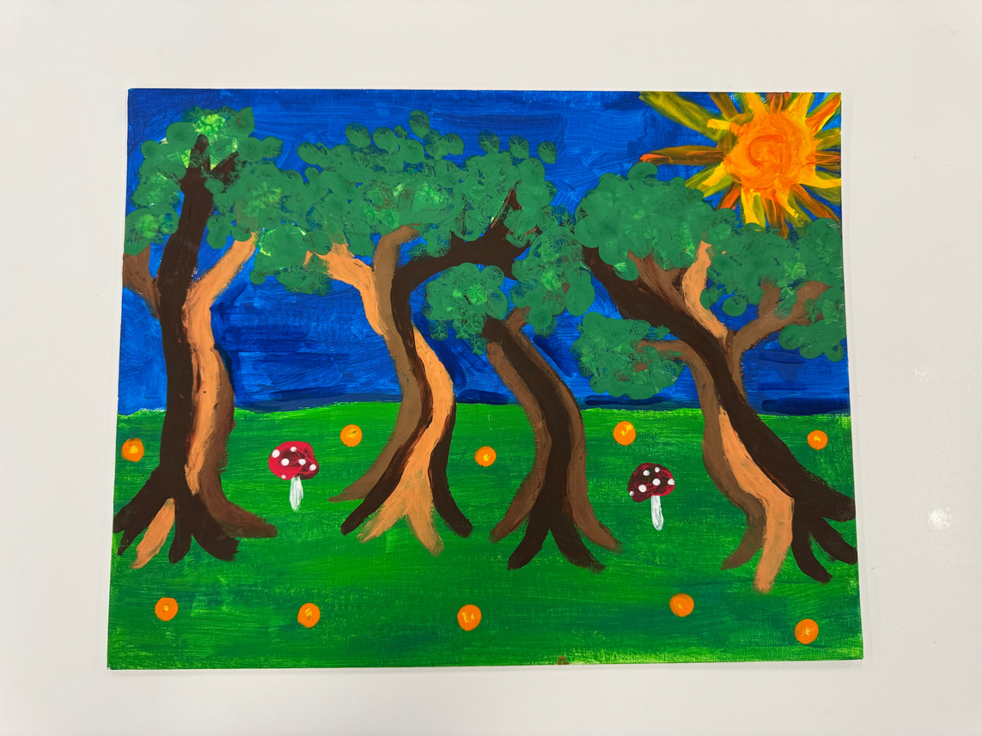
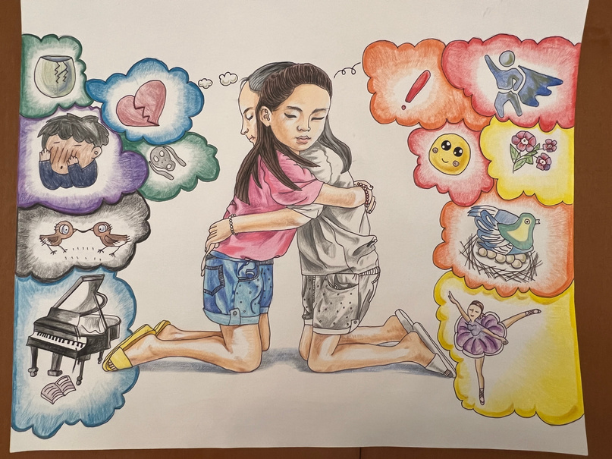
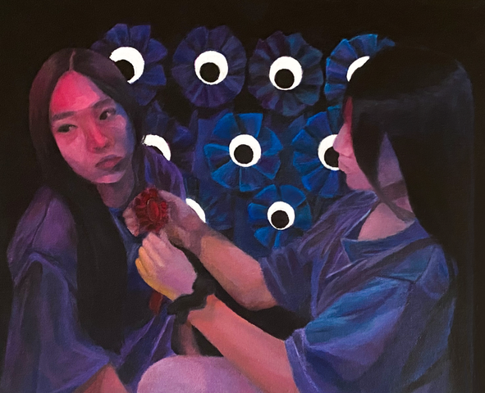

2026-2027
Reflections Program

Slide 2
OUR MISSION
“To make every child’s potential a reality by engaging and empowering families and communities to advocate for all children.”

Slide 3

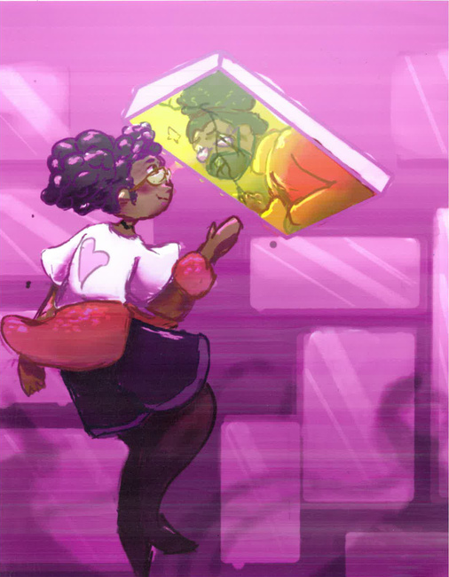
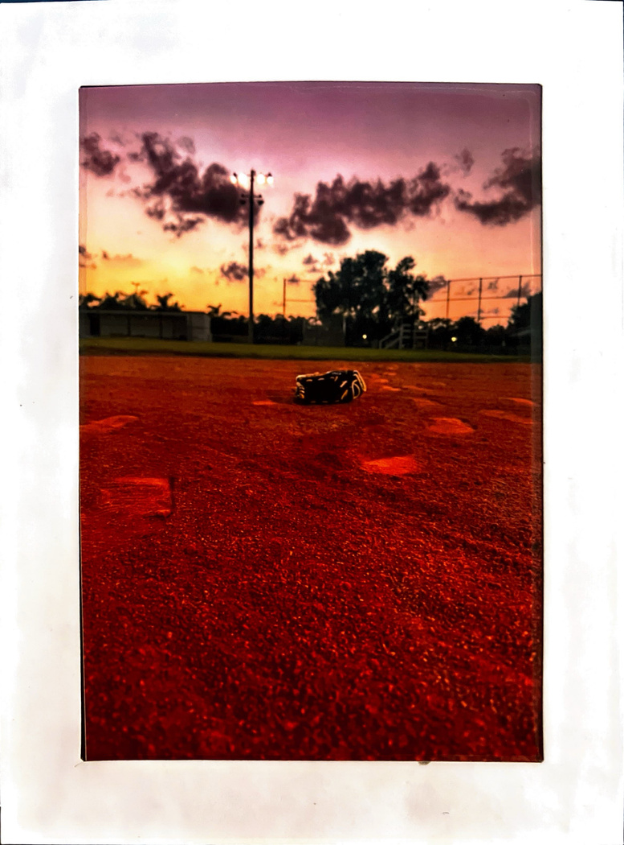
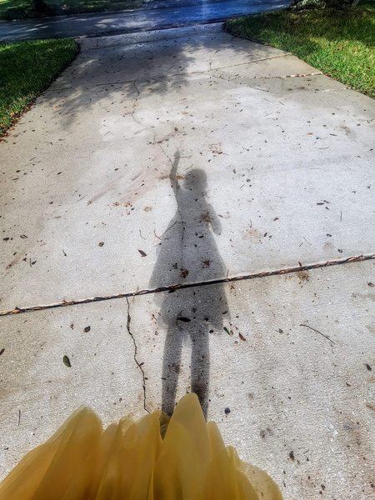
FOUR FACTS ABOUT REFLECTIONS
Founded in 1969, PTA Reflections is known as our oldest and largest national student recognition program in the arts.
The program encourages children to reflect on a common theme and create original artwork in literature, visual and performing arts.
Each year, PTAs engage over 300,000 students and their families in Arts Education, and is a valuable tool for strengthening school-community partnerships.
Participation in arts programs, like PTA Reflections, plays a critical role in students’ success by leveling playfields and developing students holistically.

Slide 4
LOCAL UNIT
REFLECTIONS CHAIR DUTIES
The PTA Reflections program is now offered via a digital format. The general tasks for local unit Reflections leaders include:
Register your PTA’s participation in this year’s program with National PTA.
Distribute program materials.
Recruit volunteer judges – EARLY!!!
Collect entries & coordinate judging.
Advance top entries to the next level.
Celebrate & recognize students!
Participation in arts programs, like PTA Reflections, plays a critical role in students’ success by leveling playfields and developing students holistically.

Slide 5

2024-25 SCHEDULE & DEADLINES
01
02
03
Local Units
County Councils
National PTA
Set your submission deadline in keeping with your County Council’s or Region Reps’ deadlines.
Sample Schedule
•Mid-October to mid-November – review entries and complete local judging
•Mid-November – Deadline to advance your winning entries to next level
Units in a council advance to council Reflections chair. Units not in a council advance to Region Reflections Chair.
  County & Regional judging should be completed by December 2026.
  All entries must be uploaded by County Council Chairs to the National PTA Student Entry portal by January 11, 2027 for State advancement.
*Only County Council Relfections Chairs may upload advancements*
  May: National Reflections winners announced
State PTA
  March 1, 2027 – Entries that won at state level due to Nationals.
  Early April – State winners announced.
  State ceremony - TBD

Slide 6





NATIONAL PTA REFLECTIONS
THEME SEARCH CONTEST
Reflections
Theme Search
The Reflections program theme is chosen each year from hundreds of suggestions submitted by students across the country.
Students at schools with a PTA in Florida, even if the PTA does not participate in the Reflections program, can submit their suggested themes. Submit themes to Florida PTA by October 17th. The Reflections Committee then selects the top 5 entries to be advanced to the National PTA.
One national winner is selected by the National PTA in February. The winning student receives a $100 award and national recognition.
Your Idea Could
Inspire the Nation!

Slide 7







2026 - 2027 REFLECTIONS THEME

Slide 8
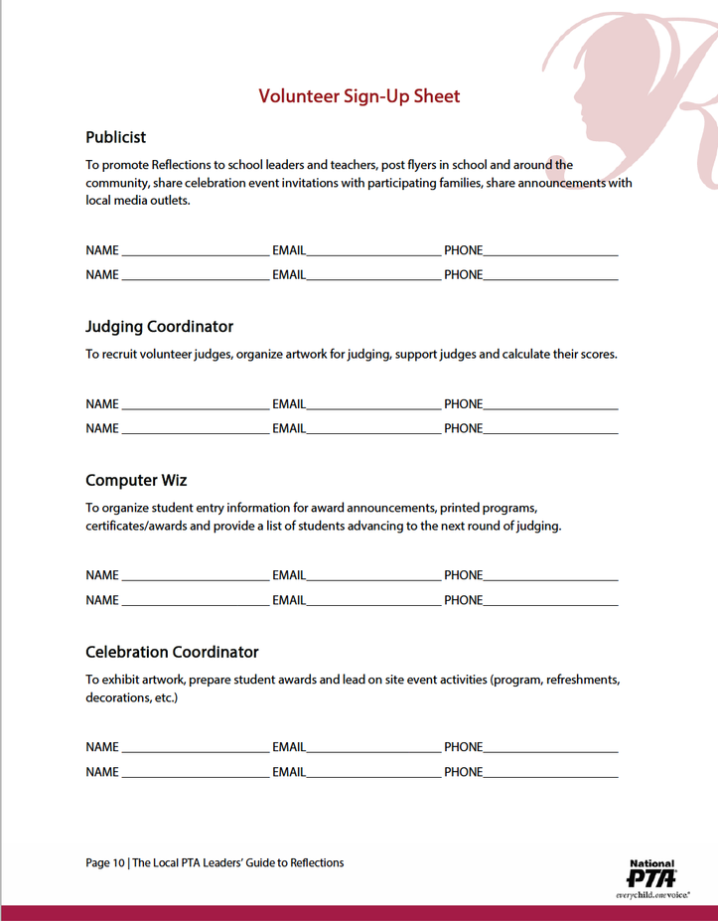
STEP 1: REGISTER. CONNECT. RECRUIT.
  Register your PTA with National PTA Reflections program at PTA.org/Reflections (Local Units must be in compliance in order to participate in Reflections).
  Make sure your PTA is registered as participating in Reflections with the state office.
  Visit the Reflections pages on the Florida PTA website to get all details for our program
  Kick off your program by celebrating Art in Education!
  Recruit Volunteers for your Reflections Committee & delegate tasks:
Promote Program
Coordinate Judging
Host Celebration Events

Slide 9
STEP 2: CUSTOMIZE & DISTRIBUTE
All entries are to be submitted digitally to State.
Edit program materials to include:
  Available arts categories for participation
  Program deadlines
  Directions for submitting entries
  Distribute to program participants
  Student Entry Forms – Google form or paper
  Rules & Instructions
INCLUDE ADDITIONAL details in the Student materials like:
  Contact information
  Submission instructions (e.g., physical vs. digital)
  Additional rules for student eligibility

Slide 10
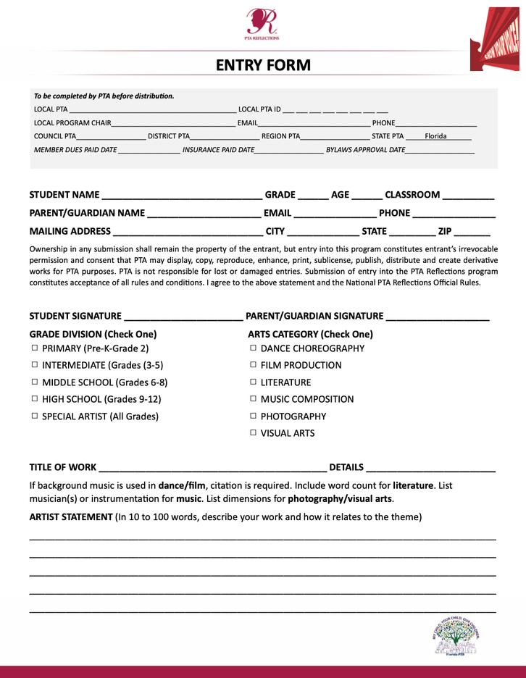
101
ENTRY FORM
LOCAL UNIT REFLECTIONS CHAIRS MUST COMPLETE ALL FIELDS IN THE PTA BOX – IDEALLY BEFORE COPYING!
{
{
STUDENT INFORMATION
STUDENT & PARENT SIGNATURES (ELECTRONIC SIGNATURES OK)
{
SUBMISSION CATEGORY
& GRADE DIVISION
TITLE (REQUIRED) &
SUBMISSION DETAILS
{
{
ARTIST STATEMENT (REQUIRED)

Slide 11
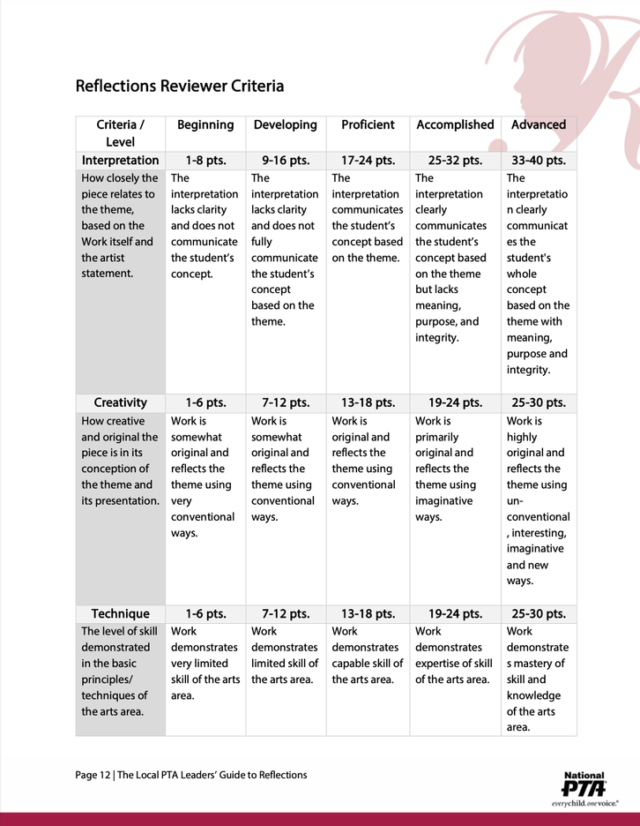
STEP 3: COORDINATE JUDGING
Tap into the community around you when recruiting judges. Consider the following potential community members:
  Having school or district administrators serve as judges to increase recognition of the program and the arts.
  Local art professionals like art teachers, artists or art businesses people will have connections and can serve as special “celebrity” judges.
  Former judges and Reflections advocates. Using kept records from past program years, reach out to reengage or find new volunteers.
  Students and arts professors from local colleges and universities. These individuals may be looking for ways to get involved in their community.
  Former state-level Reflections winners and recent graduates. These folks already know and love the program– recruit them and let them feel like experts themselves!

Slide 12

STEP 4: ADVANCEMENT & CELEBRATE
Advancement:
Advance finalists to the next level according to Florida PTA guidelines and Deadlines.
  Local Units are to send their top 3 entries in each category/division to County.
  County Council are to advance top 3 entries in each category/division to Florida PTA by January 11, 2027 via National PTA Reflections portal. Portal may only be used by County Council Reflections Chairs and their committee members.
Celebrate your students:
  Assign awards by art categories and grade division.
  Announce winners on school websites and social media and tag
  Offer awards from ShopPTA.com and donated prizes from community supporters.
  Host a student recognition event for families.
  Showcase student works at school and in the community.
Social Media Tags
@Reflections
@FLPTAReflections
@FLPTA
@PTAReflections
#artsed
#showusyourart

Slide 13
STEP 5: DON'T FORGET TO WRAP-UP!
Make sure to thank students, parent leaders, school personnel, Judges, and community businesses for their support!
Return non-advancing works and contact students who are advancing in the competition.
Host a debrief with your volunteers committee.
Update your PTA/PTSA Executive board with results.
Record notes and contacts for next year’s Reflections Chair.

Slide 14






ARTS CATEGORY &
GRADE DIVISION OVERVIEW
All entries must be an original creation done by a single student for this year’s Reflections theme.
Art Categories:
  Dance Choreography
  Film Production
  Literature
  Music Composition
  Photography
  Visual Arts
Grade Divisions:
  Primary: Pre-K thru Grade 2
  Intermediate: Grade 3 – 5
  Middle School: Grade 6 – 8
  High School: Grade 9 – 12
  Accessible Arts (ALL GRADES)

Slide 15

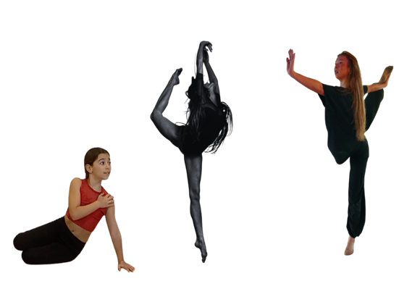
DANCE CHOREOGRAPHY CATEGORY
Key Points :
Solo and ensemble works of all dance styles are accepted. Entrant must be the choreographer and may also be the performer, or one of the performers. If background music is used, cite it on the entry form.
Video Requirements :
  Length must not exceed 5 minutes
  File size 1000MB or less
  Accepted formats: AVI, MP4, MOV

Slide 16
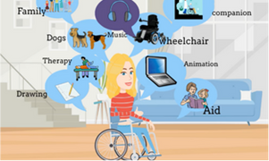
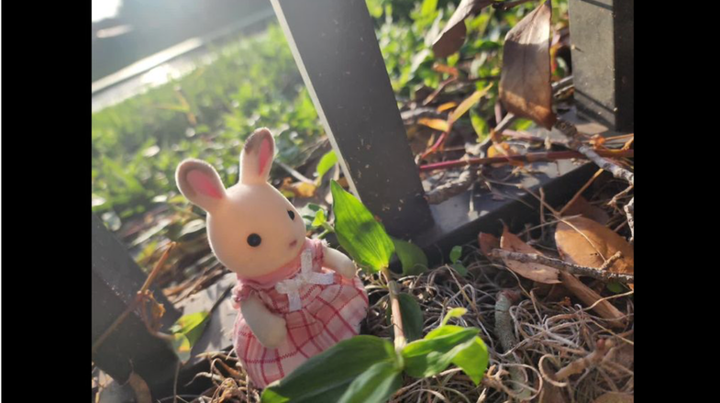
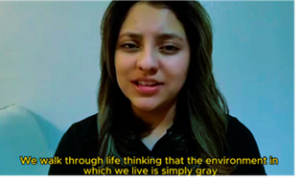
FILM PRODUCTION CATEGORY
Key Points :
Accepted short film styles include: Animation, narrative, documentary, experimental or media presentation. All screenwriting, directing and editing must be done by the student producer. If background music is used, cite it on the entry form.
Video Requirements :
  Length must not exceed 5 minutes
  File size 1000MB or less
  Accepted formats: AVI, MP4, MOV
  Use of PowerPoint is prohibited.

Slide 17
LITERATURE CATEGORY
Key Points :
Accepted forms of fiction and nonfiction include: prose, poetry, reflective essay, screenplay, and play script, narrative, and short story. Entrants may write in their primary language if an interpretive English translation is also attached. Use of copyrighted material is prohibited.
Be Perfect
My Top Front Teeth
Accepting Imperfection
The Reality of Reflections
Perfect Illusion
Other Considerations:
  Must not exceed 2,000 words
  Must include word count on application form
  May be handwritten or typed
  Single-sided print on 8 ½x11” paper
  PDF file
Imperfectly Perfect
Embrace Yourself
The Perfectly Imperfect Cross

Slide 18
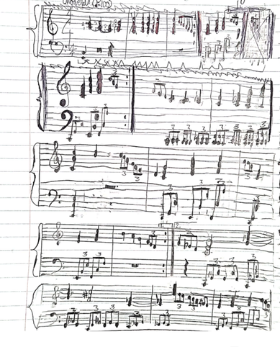
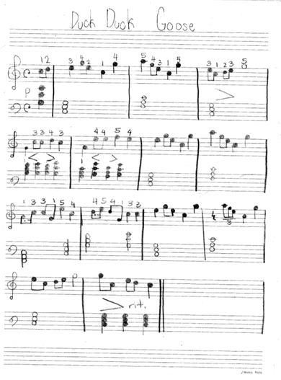
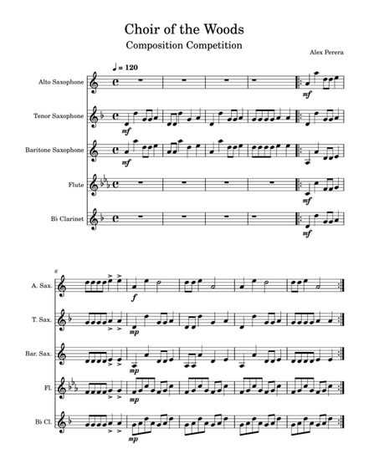
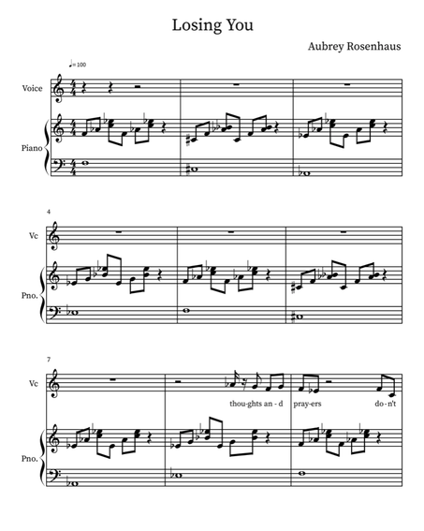
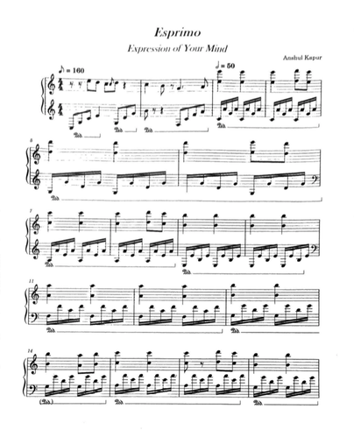
MUSIC COMPOSITION CATEGORY
Key Points :
All music styles and combinations of instrumentation are accepted. Entrant must be the composer and may also be the performer, or one of the performers. Use of copyrighted material is prohibited.
Audio/Video File Requirements:
  Length must not exceed 5 minutes
  File size 1000MB or less
  Acceptable file formats are: MP3 and WAV files
  Music Notation required for Middle and High School.
USE OF COPYRIGHTED MATERIAL IS PROHIBITED.

Slide 19
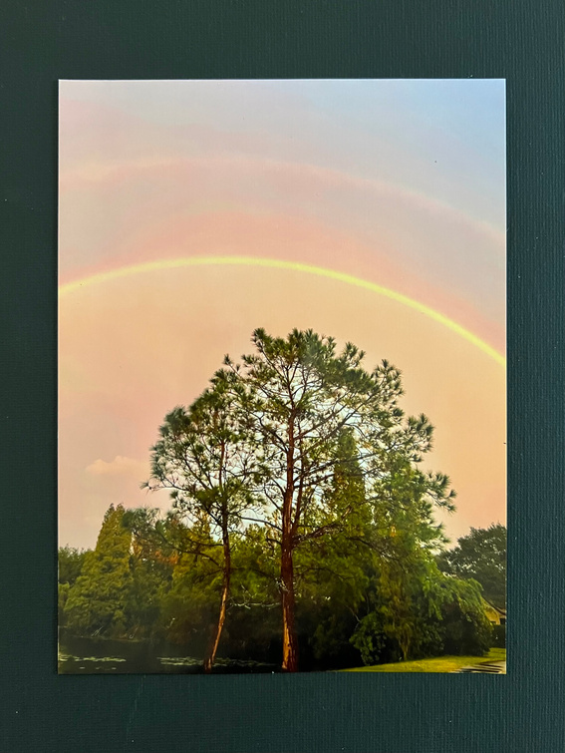
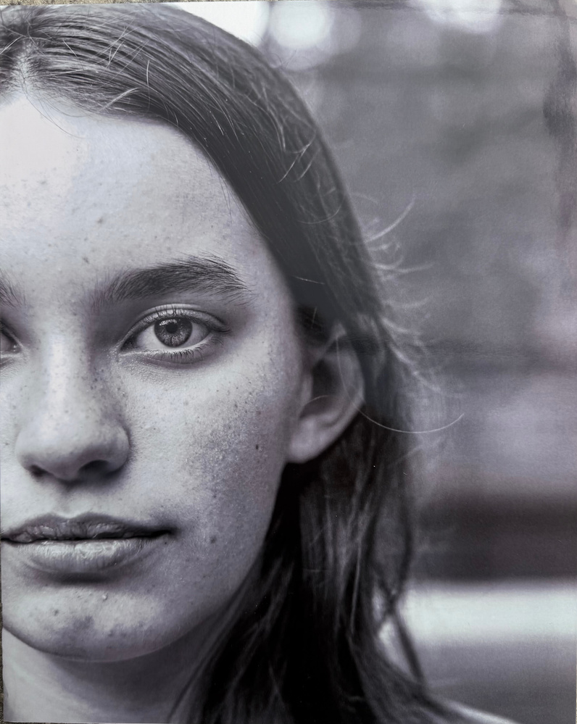
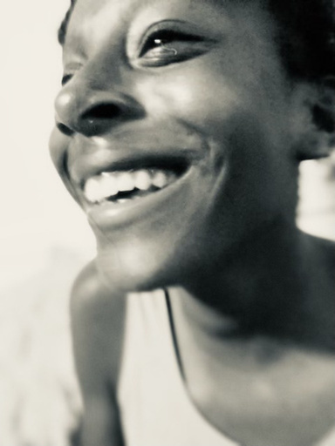
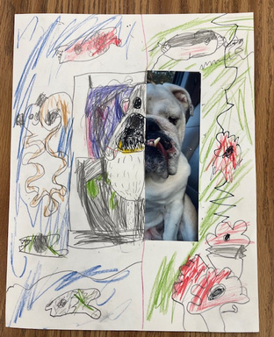
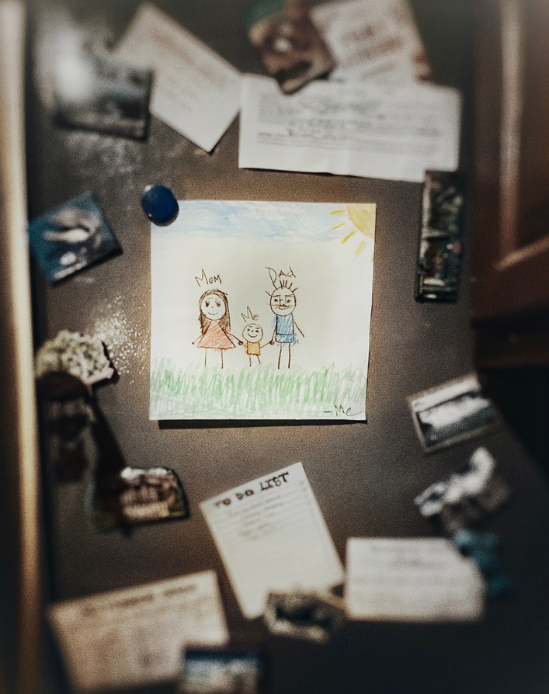
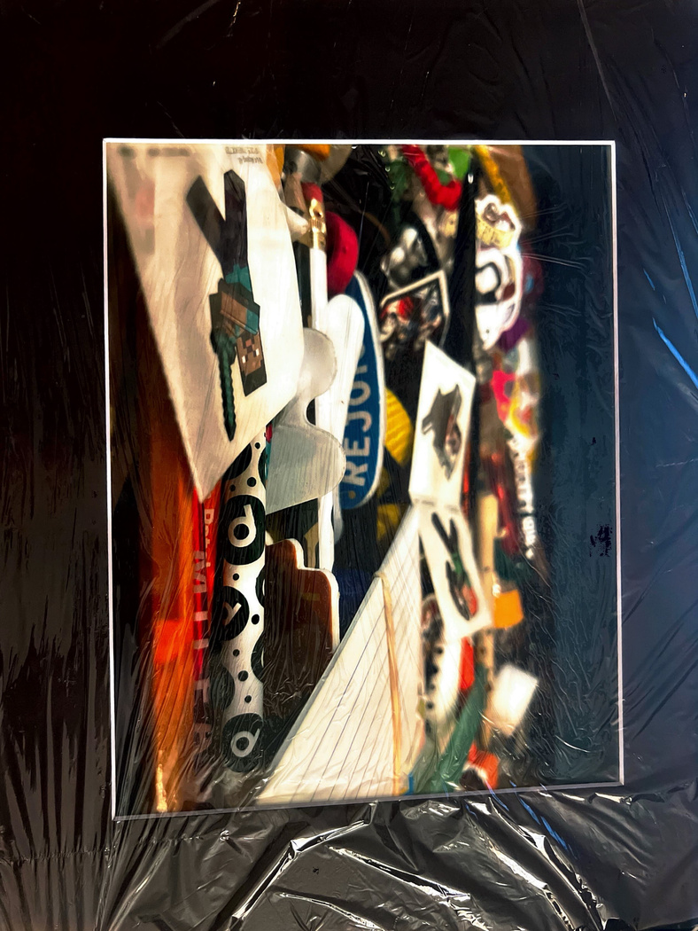
PHOTOGRAPHY CATEGORY
Key Points : Photo must be a single print/digital image. Collages or collections of photos are not accepted. Entrant must be the photographer & may use a variety of digital editing techniques including, but not limited to, multiple exposure, negative sandwich & photogram.
Prints:
  Must be no smaller than 5 x 7” & no larger than 8 x 10”
  Mounted on mat or poster board no larger than 11x14”
  Framed prints are not accepted
  Include one digital image of artwork with your submission (jpeg, jpg, png)
Digital Images:
  Dimensions must be at least 640x960 pixels and 300 dpi
  Accepted file formats: JPEG, JPG, PNG

Slide 20
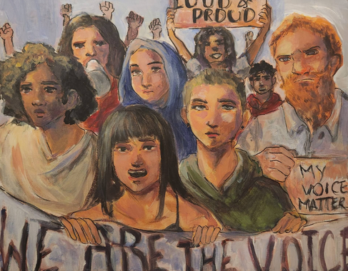
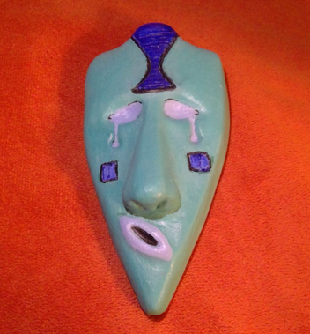
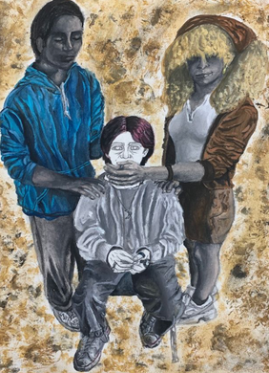
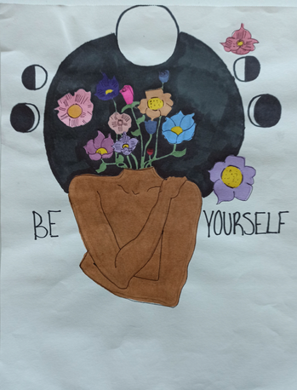
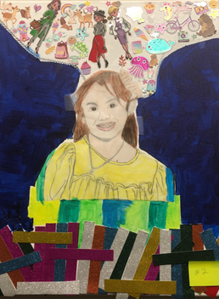
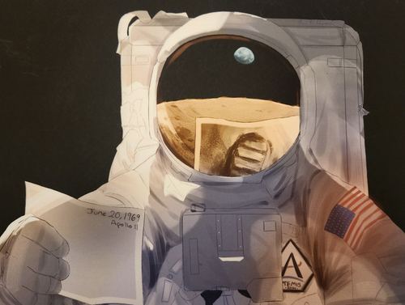
VISUAL ARTS CATEGORY
Key Points: Works of both fine and design arts are accepted, including but not limited to: architectural drawing & models, ceramics, collage, computer generated images, graphics, crafts, drawing, fashion, jewelry, fiber work, mixed media, painting, printmaking & sculpture.
2D Works:
  Mounted on sturdy material
  No larger than 12” x 16” with matting
  Framed entries are not accepted
  Include one digital image of artwork with your submission (JPEG, JPG, PNG).
3D Works:
  No larger than 12” x 12” x 12”
  Include 3 digital images of artwork at different angles.
  File formats accepted: JPEG, JPG, PNG).

Slide 21
ACCESSIBLE ARTS
Key Points: This Accessible Arts Division welcomes students from all grades and offers non-artistic accommodations for students to participate fully in PTA Reflections. Students who identify as having a disability and receive services under IDEA, ADA, or have an IEP; Section 504 may enter in the Accessible Arts Division OR grade division most closely aligned to their functional abilities.
Accommodations:
  Non-artistic accommodations (e.g. adaptive technology; transcribing; holding a camera)
  Assistants must refrain from being involved in the artistic process (e.g. developing an artist statement, choreography, music lyrics, storyboards, etc.)

Slide 22
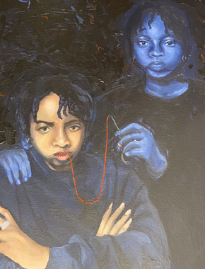
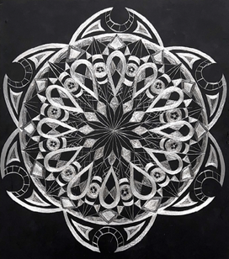
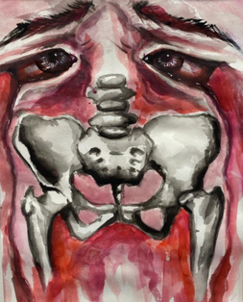
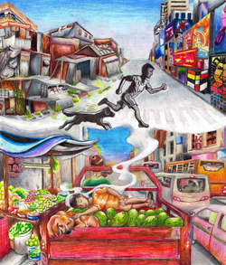
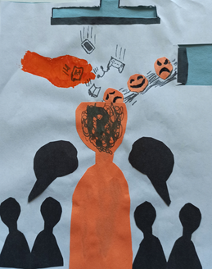
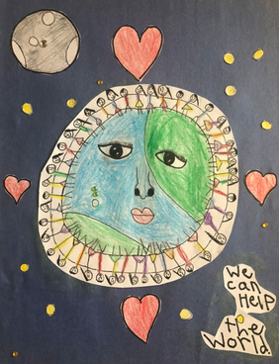
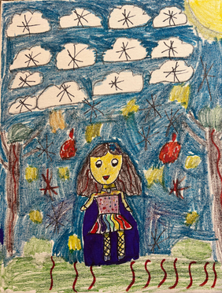
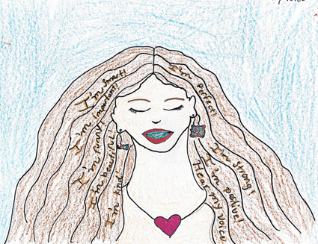
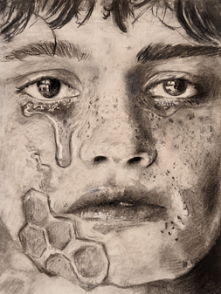
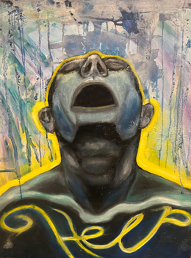
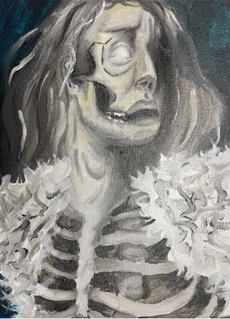
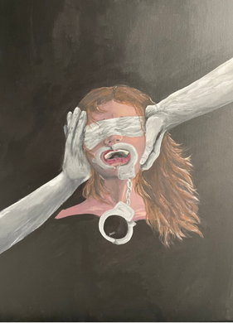
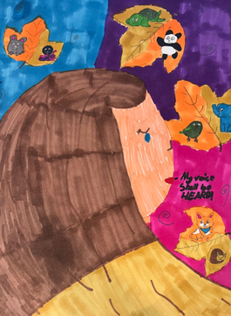
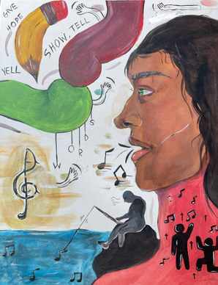

Thank you for coming!

